Slide 1

Modeling leaf responses to soil nitrogen availability
Nick Smith (Texas Tech University; nick.smith@ttu.edu)
Evan Perkowski, Lizz Waring, Christy Goodale, Dave Frey, Qing Zhu, Bill Riley, Trevor Keenan

Slide 2
Terrestrial Carbon and Nitrogen cycles are tightly coupled
Walker et al. (2020)

Slide 3
Terrestrial Carbon and Nitrogen cycles are tightly coupled
Walker et al. (2020)

Slide 4
This coupling can alter ESM predictions
“No limitation” simulation
“Nutrient limitation” simulations
Weider et al. (2015)

Slide 5
What aspects of this coupling should we be predicting with our models?
Evidence from experiments
Where we stand with models

Slide 6
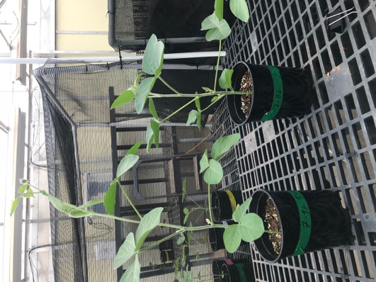
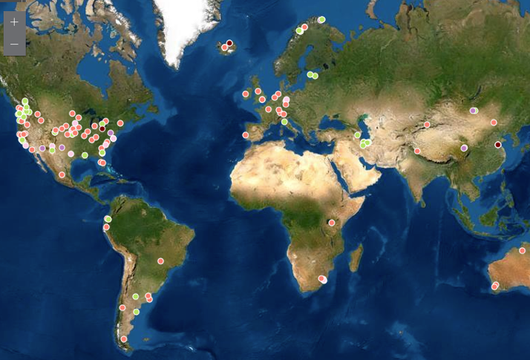
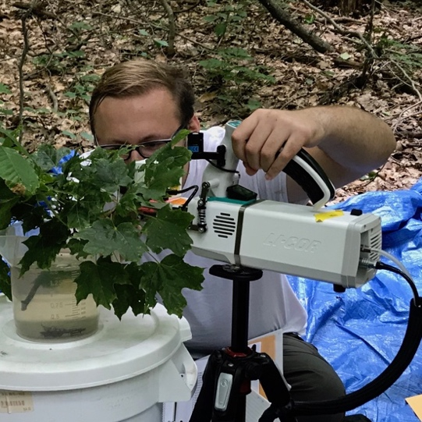
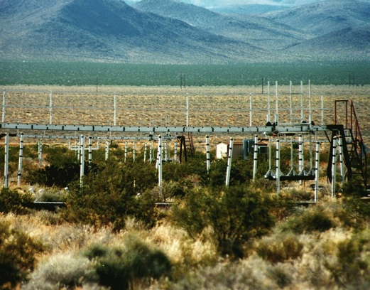
Soil nitrogen greenhouse
manipulation
Grassland soil nitrogen
manipulations
Forest soil nitrogen
manipulation
Temperature and CO₂
manipulations

Slide 7
Soil nitrogen greenhouse
manipulation
Grassland soil nitrogen
manipulations
Forest soil nitrogen
manipulation
Temperature and CO₂
manipulations

Slide 8
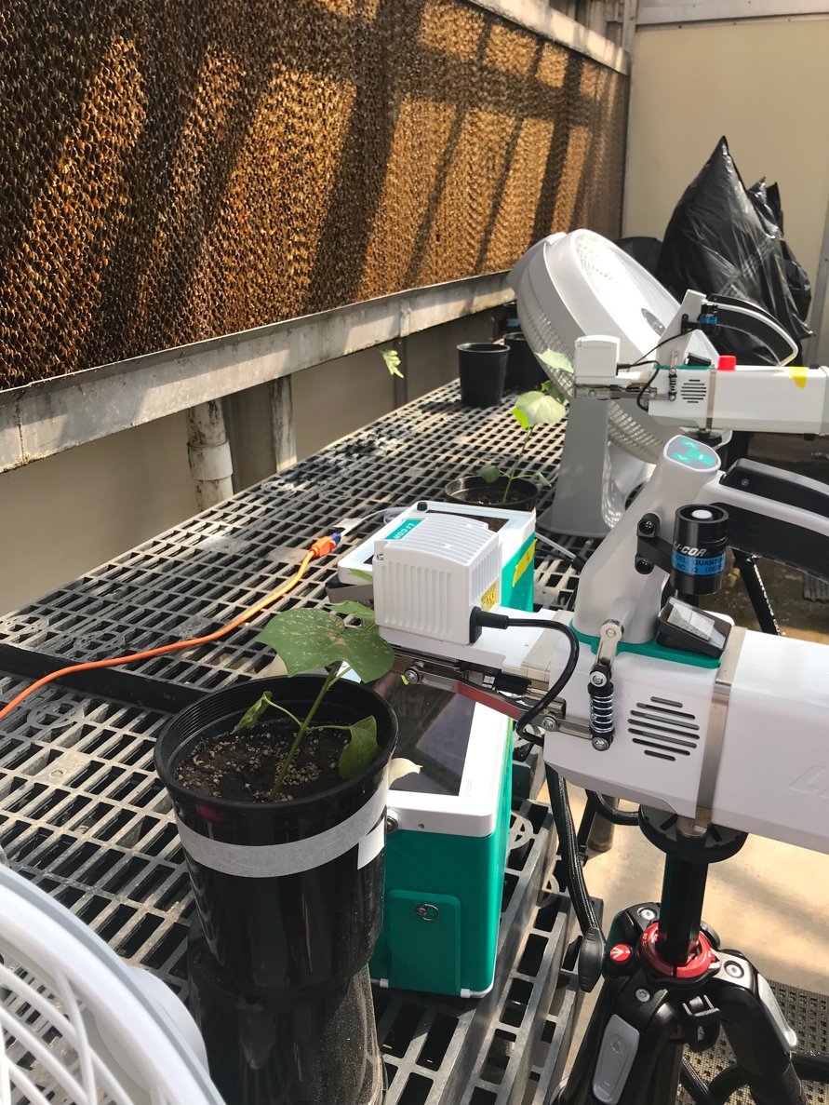
Soil N greenhouse manipulation
4 levels of nitrogen fertilization to low N field soil
0 ppm N – 630 ppm N added twice per week
4 levels of light availability
Full light (1662 µmol m⁻² s⁻¹ PAR) to 80% shade
2 species
Cotton (non-N fixing) and soybean (N fixing)
Full factorial
Physiology, allocation, and growth measured

Slide 9
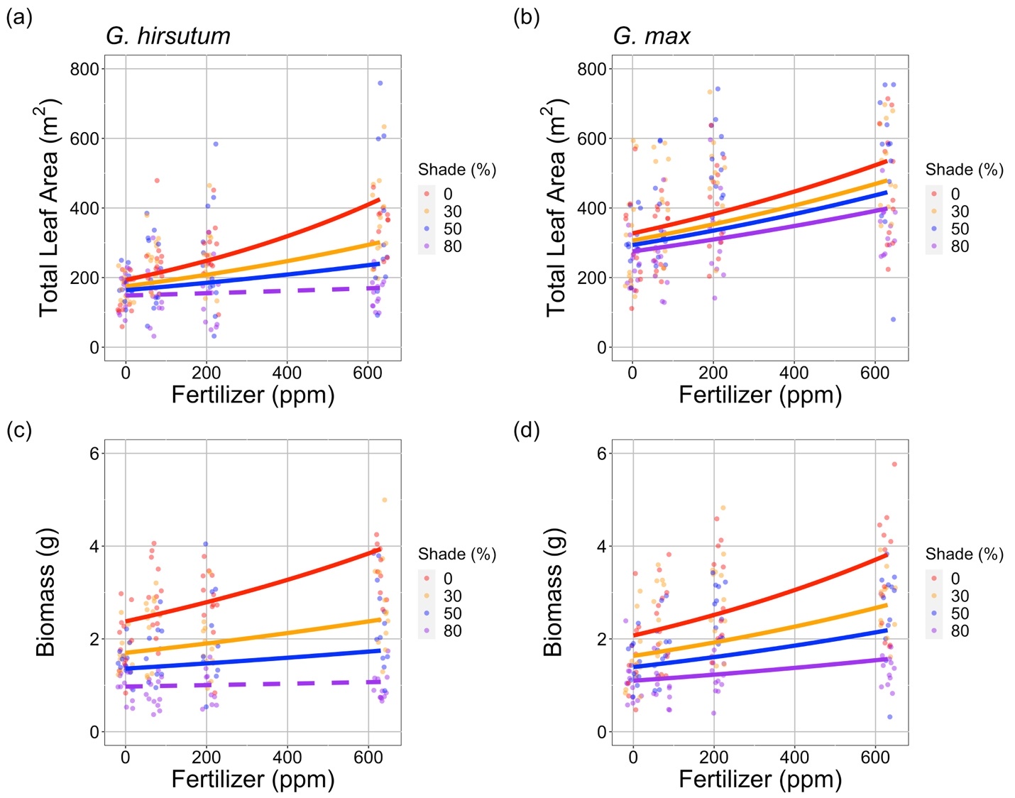
Result: Growth increases with increasing soil N
Waring et al. (in prep)

Slide 10
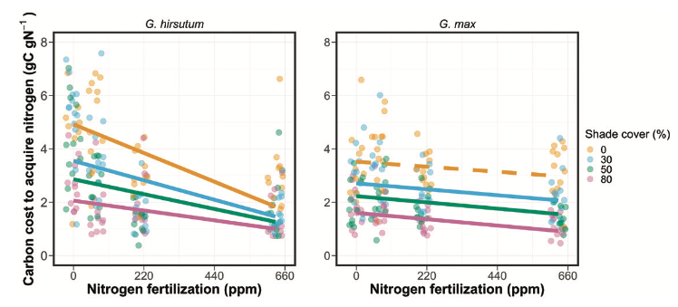
Result: C cost to acquire N decreases with increasing soil N
Perkowski et al. (2021)

Slide 11
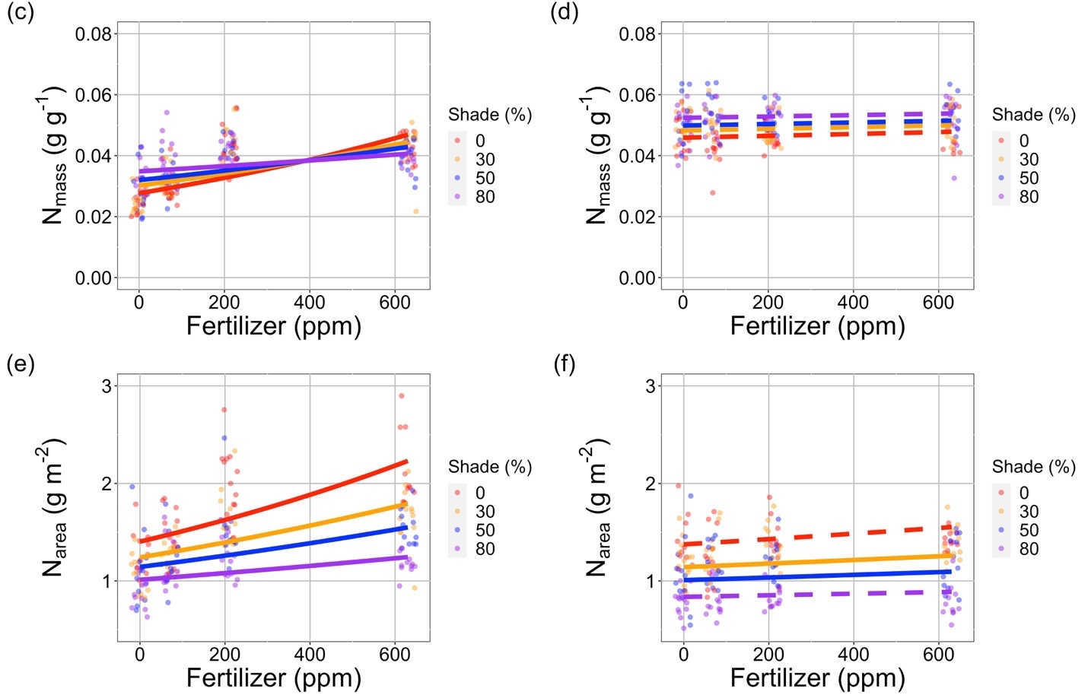
Result: Tissue N increases with increasing soil N
Waring et al. (in prep)

Slide 12
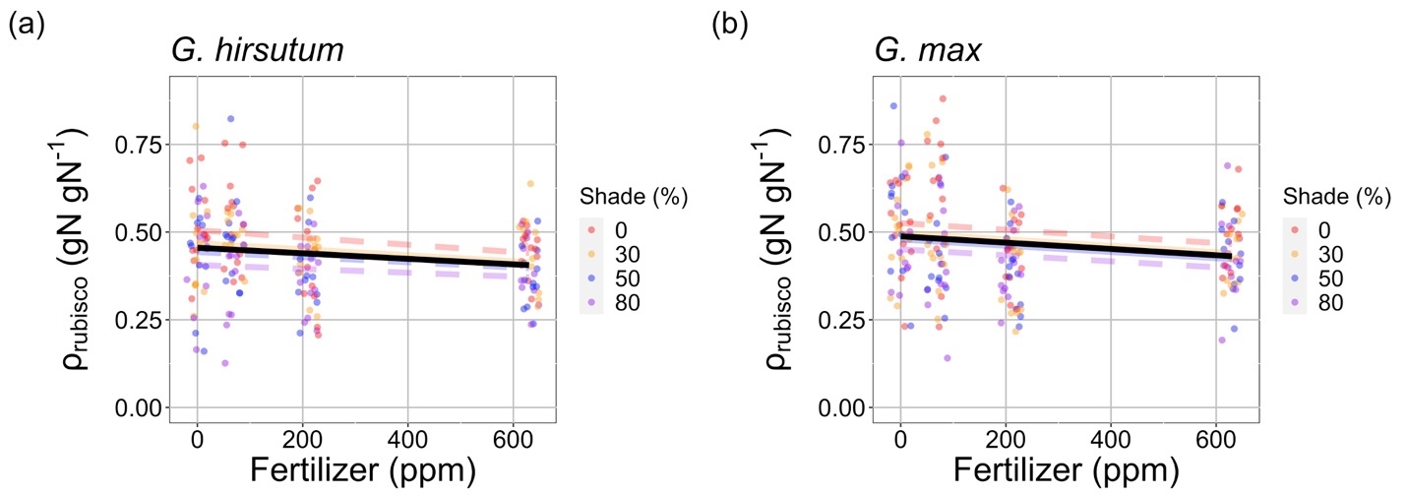
Result: Relative leaf N allocation to photosynthesis decreases with increasing soil N
Consistent across all species, treatments, and photosynthetic components (Rubisco, bioenergetics, light harvesting)
Waring et al. (in prep)

Slide 13
What should models be able to reproduce?
Increased growth with increased soil N √
Decreased C cost to acquire N with increased soil N √
Increased tissue N with increased soil N √
Decreased relative leaf N allocation to photosynthesis with increased soil N √

Slide 14
Soil nitrogen greenhouse
manipulation
Grassland soil nitrogen
manipulations
Forest soil nitrogen
manipulation
Temperature and CO₂
manipulations

Slide 15

Forest soil N manipulation
Closed canopy forest in Ithaca, NY
Various deciduous trees
2 levels of nitrogen fertilization
0 or 50 kg N ha⁻¹ yr⁻¹
2 levels of sulfur fertilization
0 or 50 kg S ha⁻¹ yr⁻¹
Full factorial
Physiology and growth measured

Slide 16
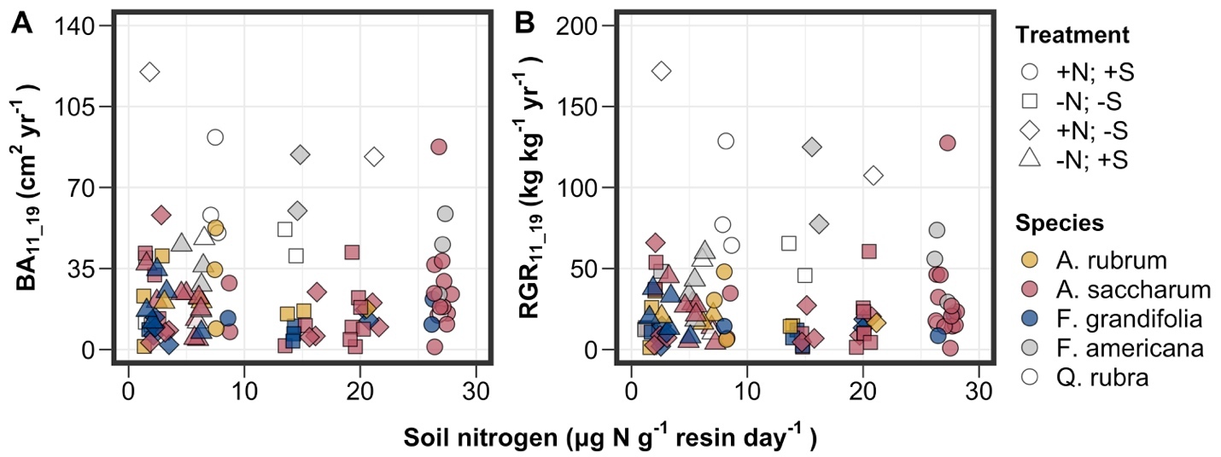
Result: Growth unchanged with increasing soil N
Perkowski et al. (in prep)

Slide 17
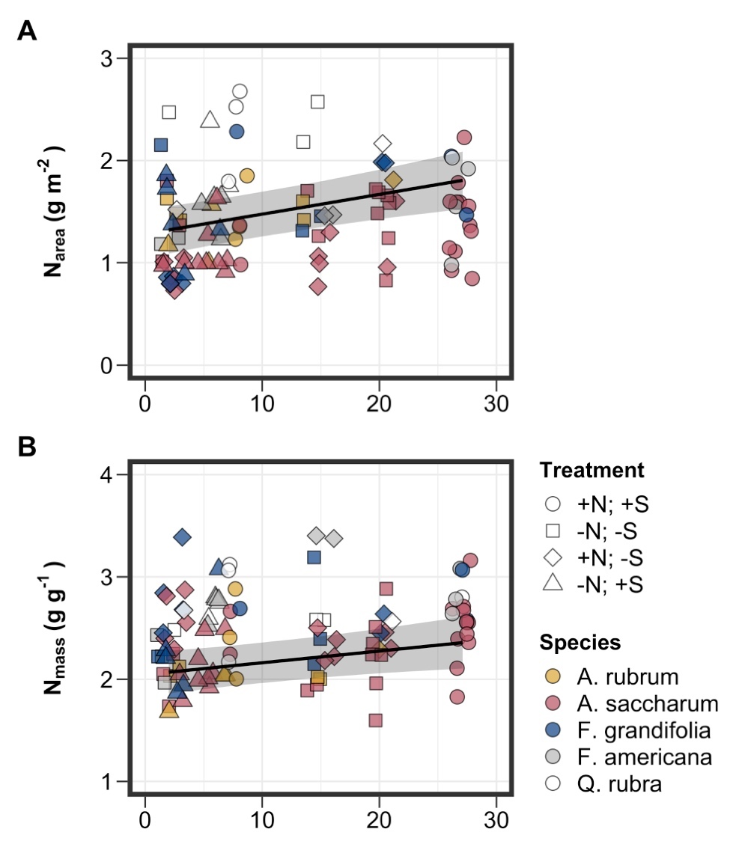
Result: Tissue N increases with increasing soil N
Perkowski et al. (in prep)

Slide 18
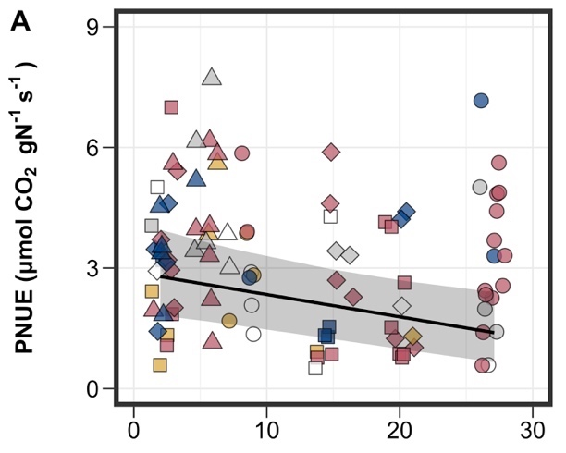
Result: Relative leaf N allocation to photosynthesis decreases with increasing soil N
Waring et al. (in prep)

Slide 19
What should models be able to reproduce?
Increased growth with increased soil N √ -
Decreased C cost to acquire N with increased soil N √
Increased tissue N with increased soil N √ √
Decreased relative leaf N allocation to photosynthesis with increased soil N √ √

Slide 20
Soil nitrogen greenhouse
manipulation
Grassland soil nitrogen
manipulations
Forest soil nitrogen
manipulation
Temperature and CO₂
manipulations

Slide 21
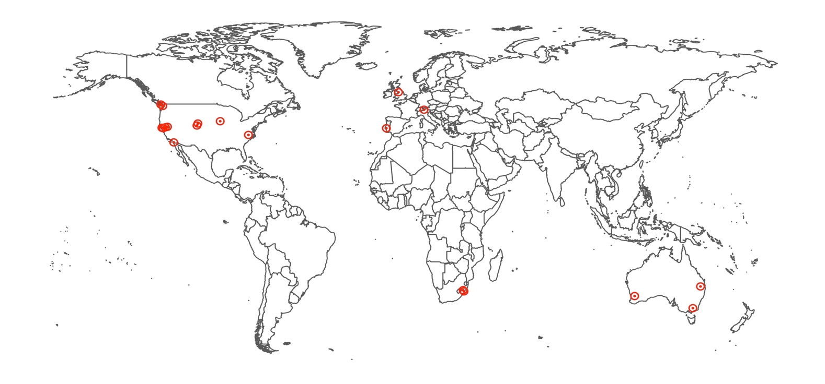
Global grassland soil N manipulations
Nutrient Network
Global grassland factorial N+P+K addition
Leaf trait dataset
19 sites
2129 individuals
208 species
Leaf N and δ¹³C
δ¹³C used to compute ratio of intercellular to extracellular CO₂ and carbon cost ratio of soil resource uptake

Slide 22
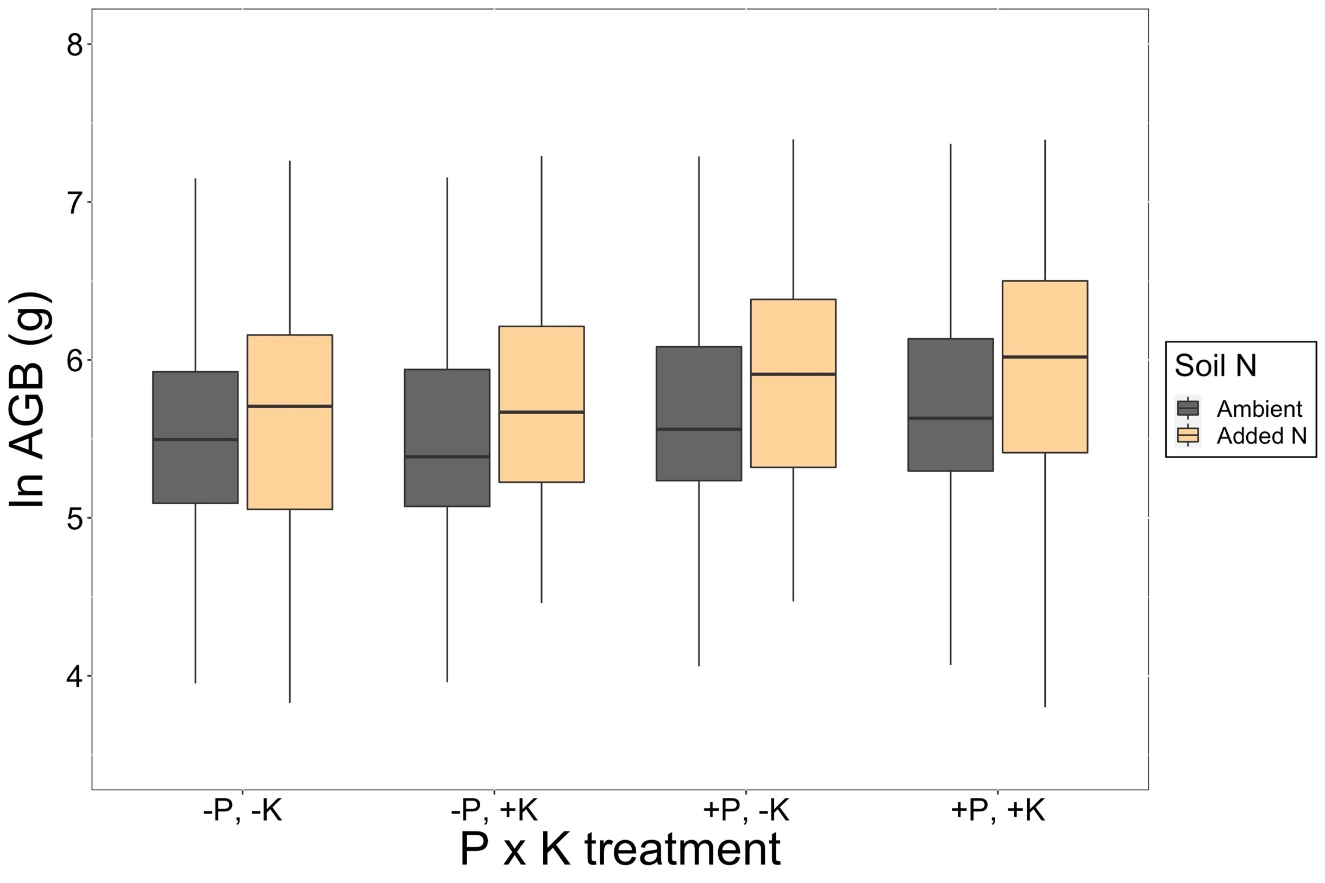
Result: Growth increases with increasing soil N
Always increases regardless of P and K
Smith et al. (in prep)

Slide 23
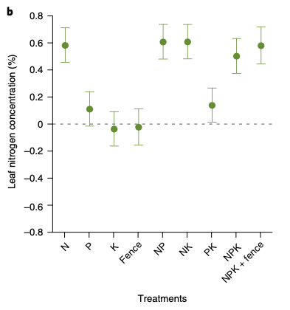
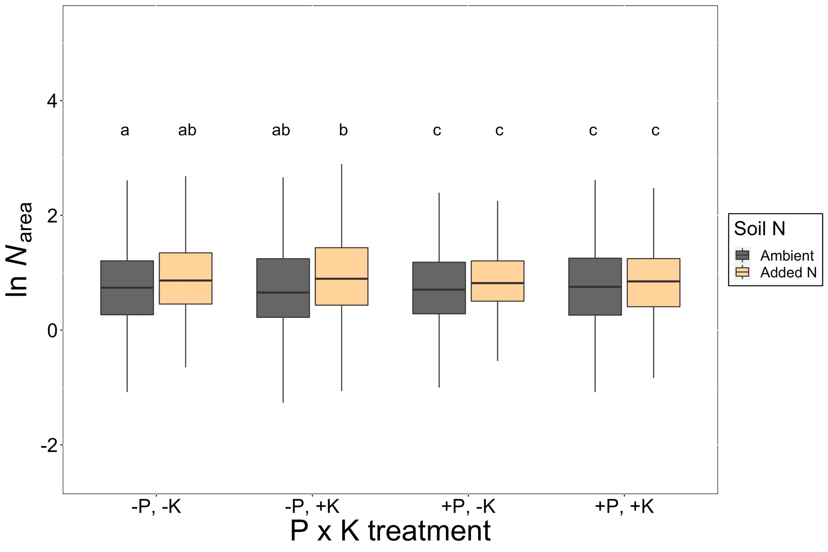
Result: Tissue N increases with increasing soil N
Firn et al. (2019)
Smith et al. (in prep)

Slide 24
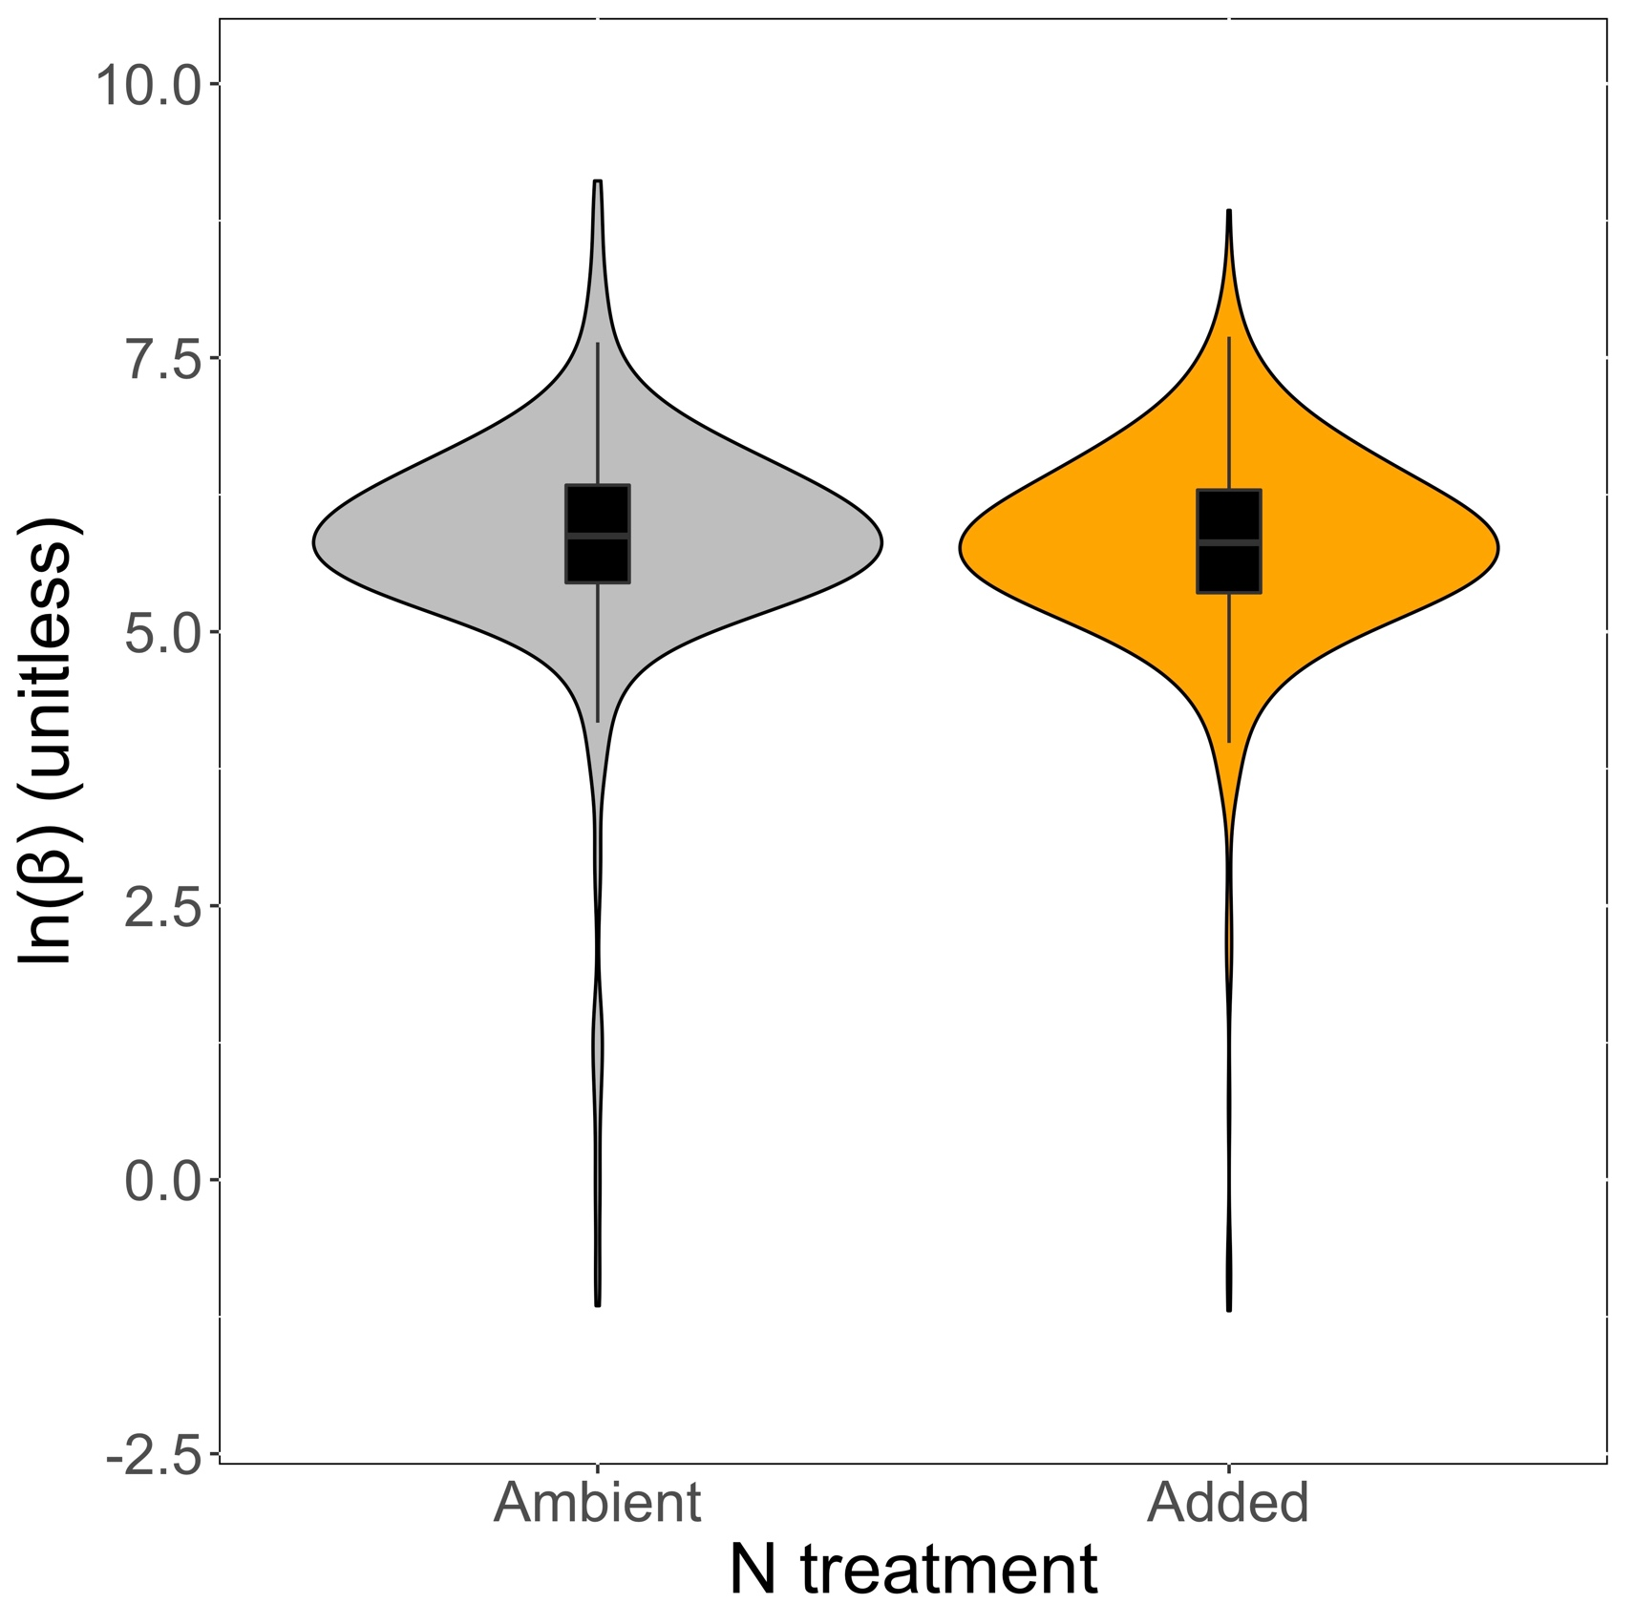
Result: Reduction in relative N acquisition cost with increased N
Change is significant, but slight (-8%)
Smith et al. (in prep)

Slide 25
What should models be able to reproduce?
Increased growth with increased soil N √ - √
Decreased C cost to acquire N with increased soil N √ √
Increased tissue N with increased soil N √ √ √
Decreased relative leaf N allocation to photosynthesis with increased soil N √ √

Slide 26
Soil nitrogen greenhouse
manipulation
Grassland soil nitrogen
manipulations
Forest soil nitrogen
manipulation
Temperature and CO₂
manipulations

Slide 27
Temperature and CO₂ manipulations
Model-data testing
2 temperature manipulation experiments
31 elevated CO₂ experiments
Leaf model simulations
Canopy model simulations

Slide 28
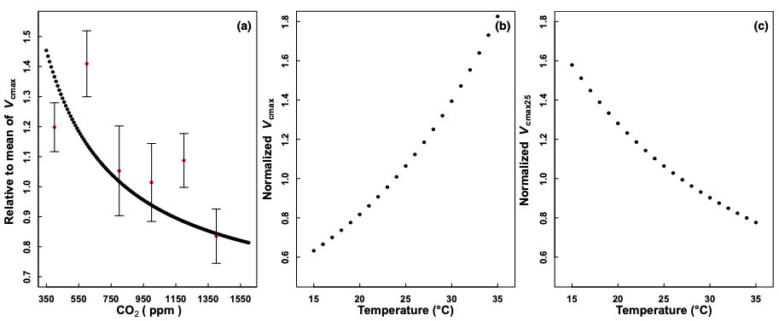
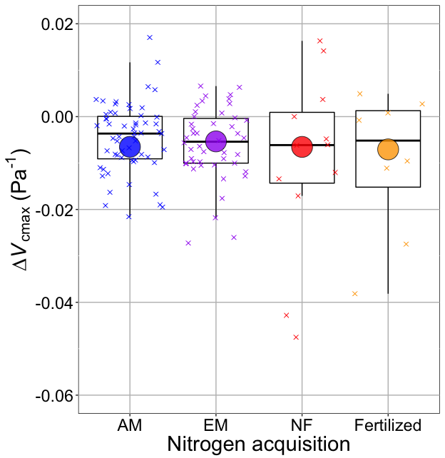
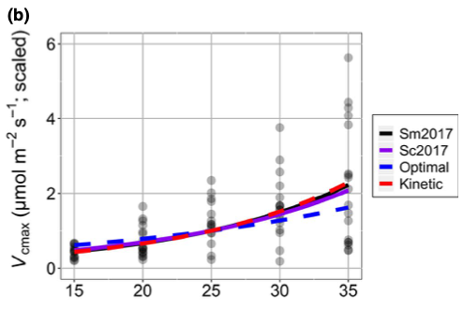
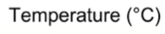
Result: elevated temperature and CO₂ reduce leaf investment in photosynthetic biochemistry
Smith and Keenan (2020)
Dong et al. (2022)

Slide 29
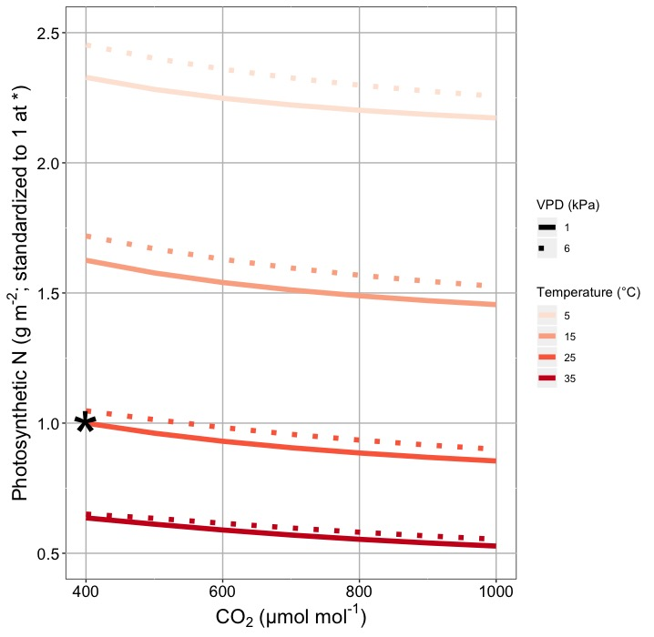
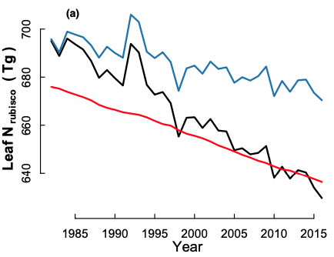
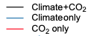
Result: elevated temperature and CO₂ reduce leaf photosynthetic N
Smith and Keenan (2020)
Dong et al. (2022)

Slide 30
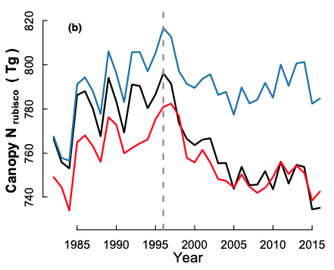
Result: elevated temperature and CO₂ reduce canopy N
Dong et al. (2022)

Slide 31
What should models be able to reproduce?
Increased growth with increased soil N √ - √
Decreased C cost to acquire N with increased soil N √ √
Increased tissue N with increased soil N √ √ √
Decreased relative leaf N allocation to photosynthesis with increased soil N √ √
Reduced N with elevated temperature and CO₂ √

Slide 32
What do models attempt to reproduce?
Increased growth with increased soil N √ - √
Decreased C cost to acquire N with increased soil N √ √
Increased tissue N with increased soil N √ √ √
Decreased relative leaf N allocation to photosynthesis with increased soil N √ √
Reduced N with elevated temperature and CO₂ √

Slide 33
What do models attempt to reproduce?
Increased growth with increased soil N √ - √
Decreased C cost to acquire N with increased soil N √ √
Increased tissue N with increased soil N √ √ √
Decreased relative leaf N allocation to photosynthesis with increased soil N √ √
Reduced N with elevated temperature and CO₂ √

Slide 34
Effect of soil N addition in CLM 5
GPP
Wieder et al. (2019)

Slide 35
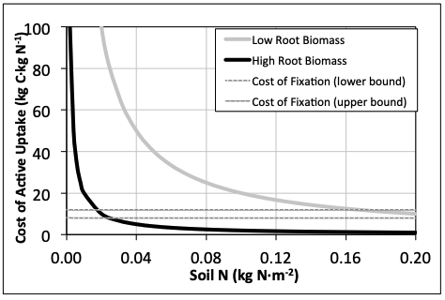
Effect of soil N on C cost of N uptake in FUN model
Fisher et al. (2010)

Slide 36
What can models reproduce reliably from theory?
Increased growth with increased soil N √ - √
Decreased C cost to acquire N with increased soil N √ √
Increased tissue N with increased soil N √ √ √
Decreased relative leaf N allocation to photosynthesis with increased soil N √ √
Reduced N with elevated temperature and CO₂ √

Slide 37
What can models reproduce reliably from theory?
Increased growth with increased soil N √ - √
Decreased C cost to acquire N with increased soil N √ √
Increased tissue N with increased soil N √ √ √
Decreased relative leaf N allocation to photosynthesis with increased soil N √ √
Reduced N with elevated temperature and CO₂ √

Slide 38
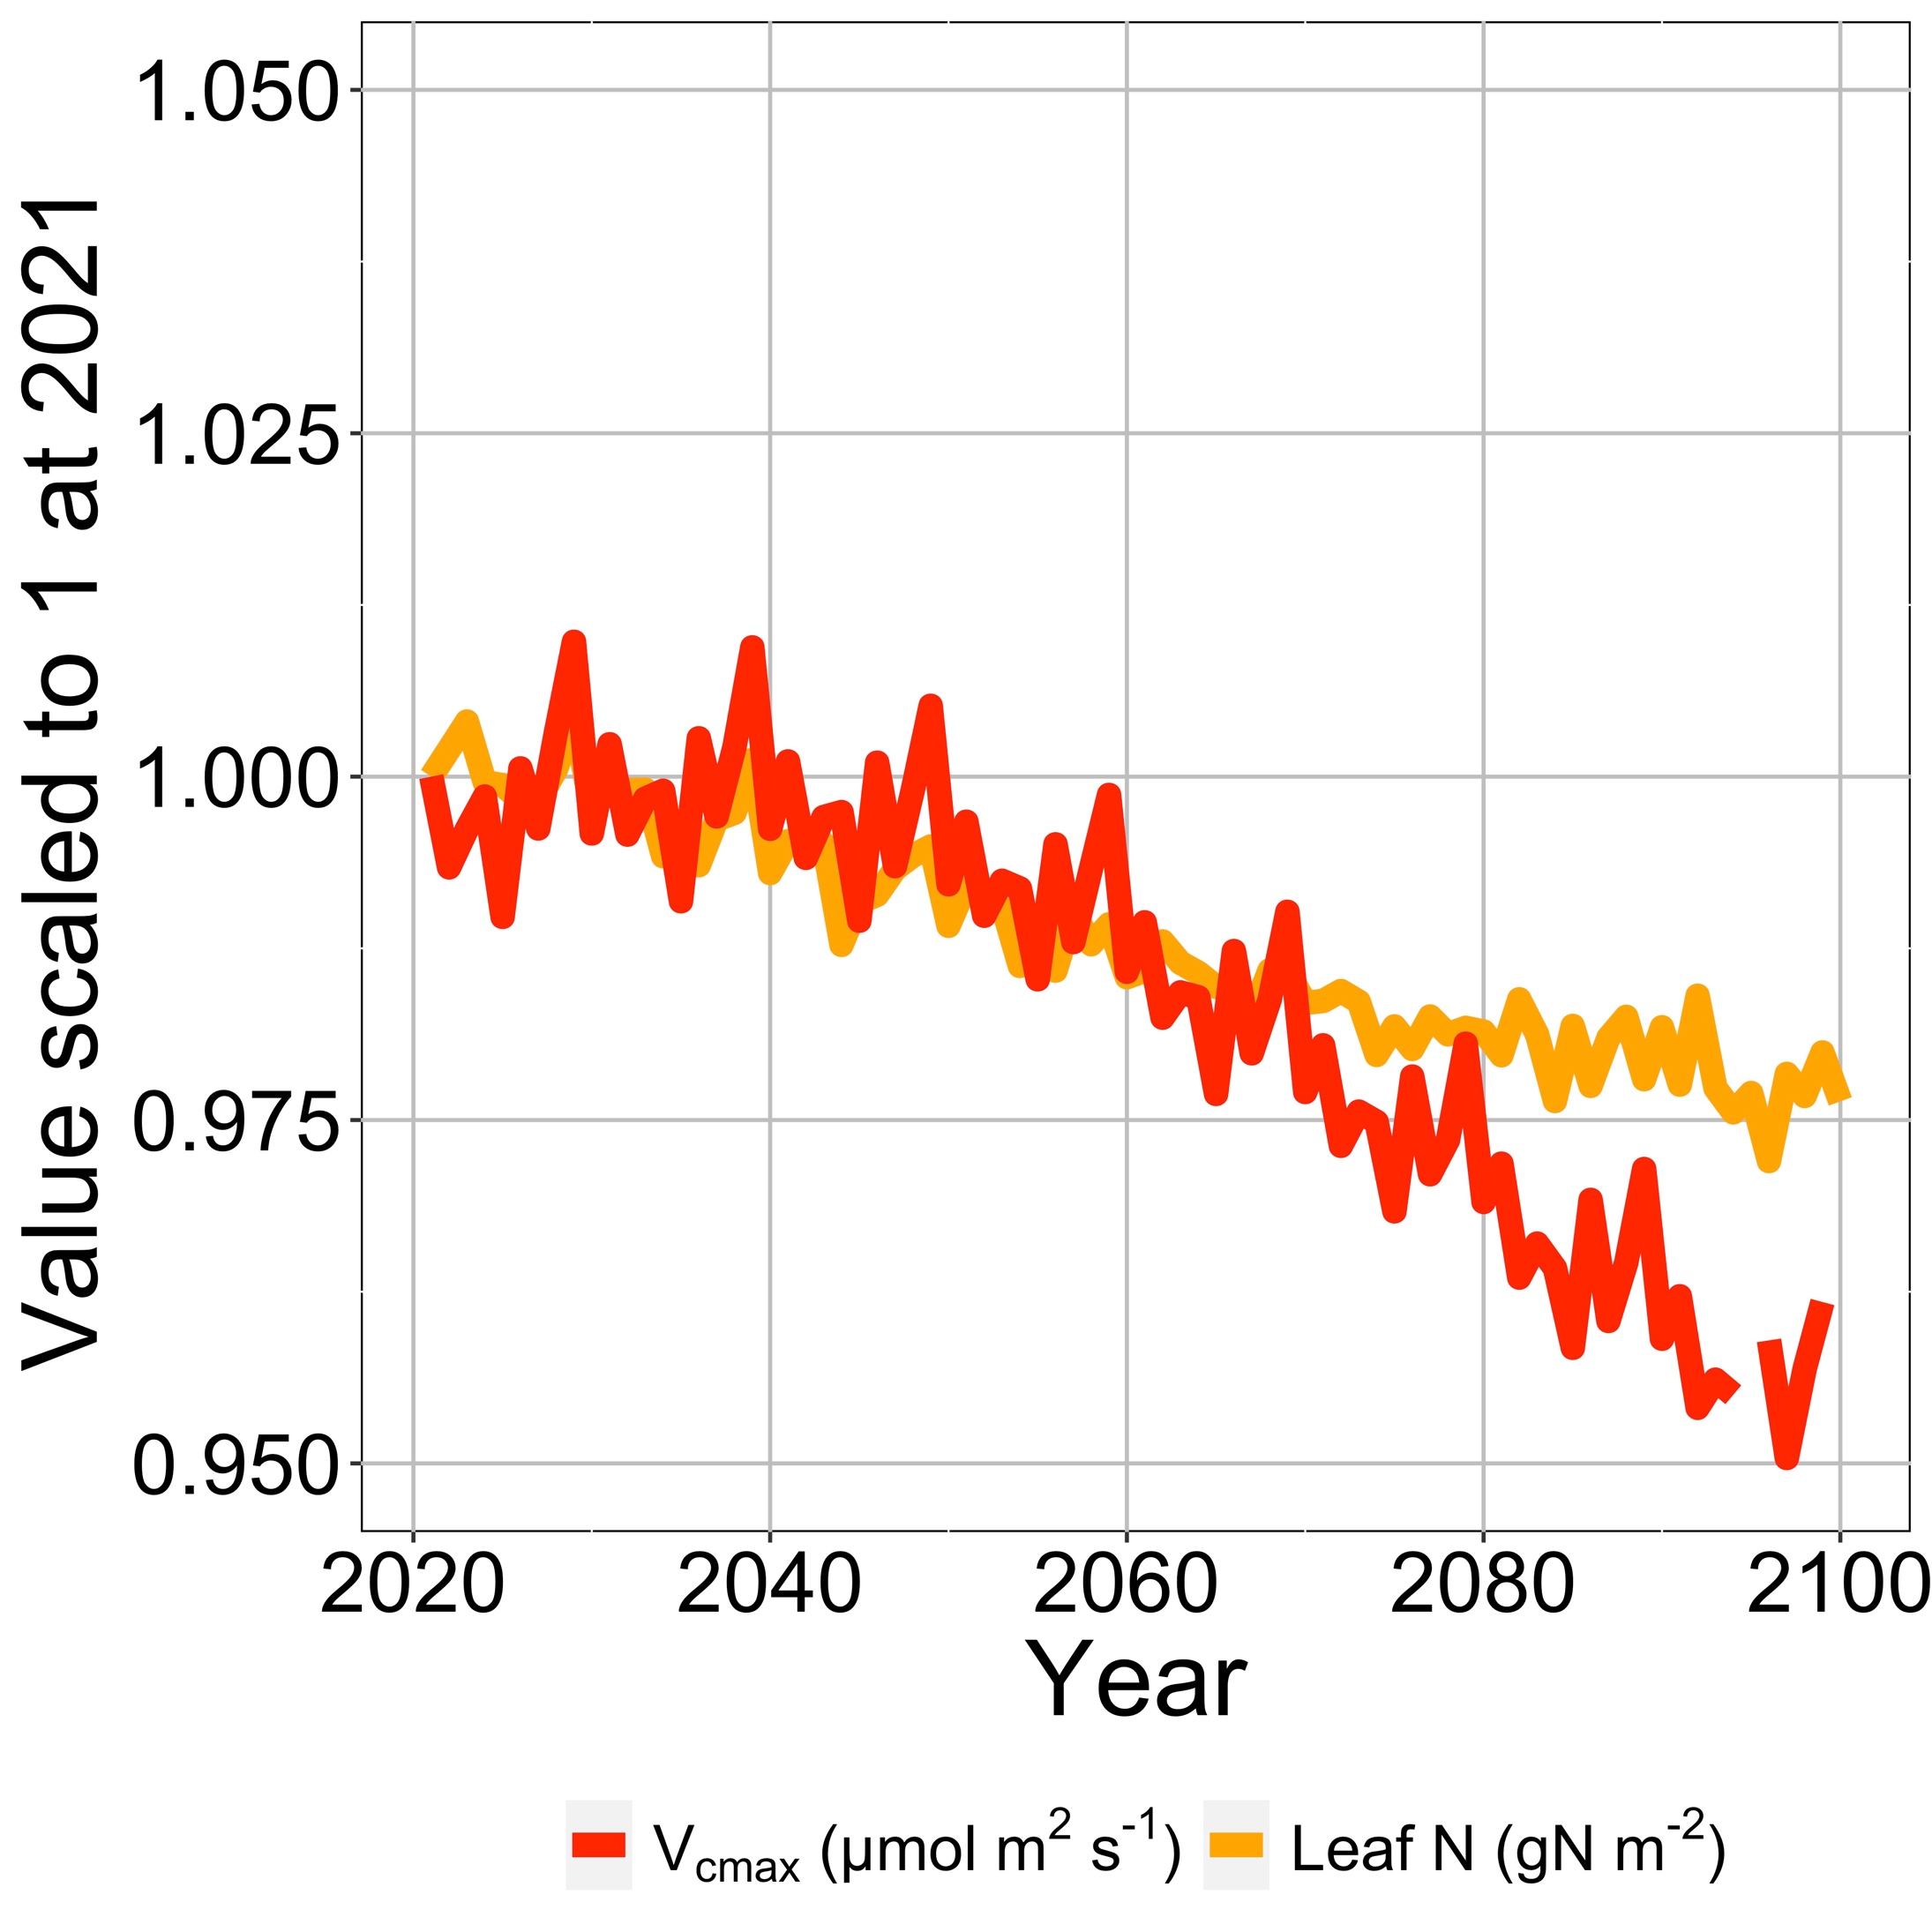
Reduced future allocation to photosynthesis and leaf N in an ELM simulation modified with EEO photosynthesis
Smith et al. (in prep)

Slide 39
What should models be able to reproduce?
Increased growth with increased soil N √ - √
Decreased C cost to acquire N with increased soil N √ √
Increased tissue N with increased soil N √ √ √
Decreased relative leaf N allocation to photosynthesis with increased soil N √ √
Reduced N with elevated temperature and CO₂ √

Slide 40
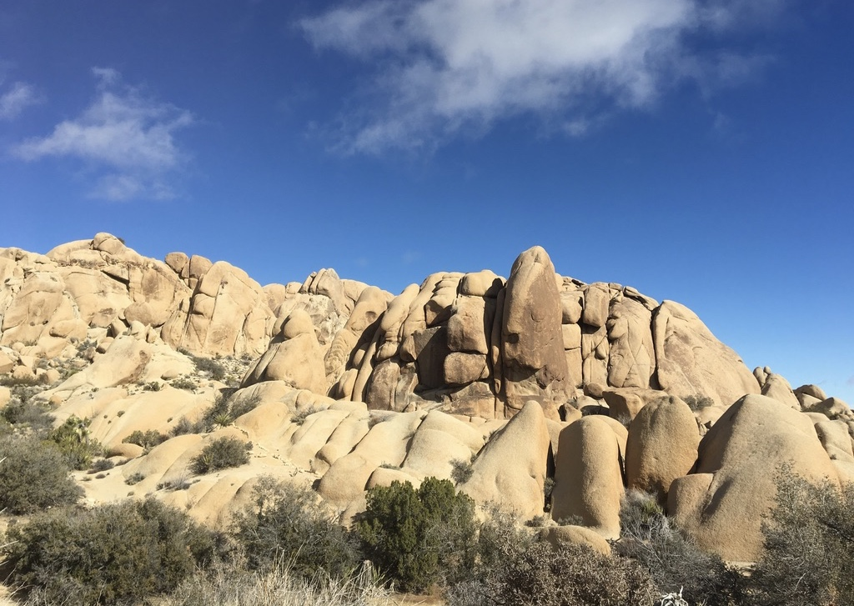
nick.smith@ttu.edu; @nick_greg_smith
Presentation available at:
www.github.com/SmithEcophysLab/mmee_2022
Thanks!

Slide 42
What can models reproduce reliably from theory?
Increased growth with increased soil N √ - √
Decreased C cost to acquire N with increased soil N √ √
Increased tissue N with increased soil N √ √ √
Decreased relative leaf N allocation to photosynthesis with increased soil N √ √
Reduced N with elevated temperature and CO₂ √

Slide 43
What aspects of this coupling should we be predicting with our models? Evidence from experiments

Slide 44
We now have theory to help predict

Slide 45
The typical paradigm
Soil nitrogen ∝ Leaf nitrogen ∝ V_{cmax}
N
N

Slide 46
The typical paradigm
Soil nitrogen ∝ Leaf nitrogen ∝ V_{cmax}
Firn et al. (2019)

Slide 47
The typical paradigm
Soil nitrogen ∝ Leaf nitrogen ∝ V_{cmax}
Walker et al. (2014)

Slide 48
Conclusions
What C-N interactions can we predict from theory
Reduction in C cost to acquire N with increasing soil N
Reduction in relative leaf N allocation to photosynthesis with increasing soil N
Reduction in leaf photosynthetic N with increasing CO₂ and temperature
What is more challenging to predict
Increased growth with increasing soil N
Increased total leaf N with increasing N

